Slide 1

Alzheimer Disease Detection and Mental Stress Analysis using EEG Signals
SRM INSTITUTE OF SCIENCE AND TECHNOLOGY
FACULTY OF ENGINEERING AND TECHNOLOGY
DEPARTMENT OF NETWORKING AND COMMUNICATIONS
18CSP109L MAJOR PROJECT
Student :Kaushik Tayi Reg No: RA2011030010048
Guide name and Designation:
Dr. Prabakeran S (Assistant Professor)
Department of Networking And Communications

Slide 2
TABLE OF CONTENTS
Abstract
Introduction
Motivation
Literature Review
Challenges and limitations in existing system
Objectives of the project
Innovation idea of the project
Scope and application of the project
Architecture
Proposed Modules and their algorithm description

Slide 3
ABSTRACT
We propose an Intrusion Detection System (IDS) optimization method using transfer learning, employing a long short-term memory autoencoder (LSTM-AE) for anomaly detection.
By leveraging knowledge from diverse datasets, our approach addresses challenges in traditional IDS methods, reducing false alarms, improving detection rates, and enhancing adaptability to new and unknown attacks.
The method demonstrates efficacy in detecting and classifying various attack types, including denial-of-service, probe, user-to-root, and remote-to-local.

Slide 4
INTRODUCTION
Alzheimer's Disease poses a significant challenge in healthcare due to its progressive nature and impact on cognition sense of human beings.
Early detection of Alzheimer is crucial for effective intervention and management of the disease leading the patient to survive a comfortable life.
EEG (Electroencephalogram) signals offer valuable insights into brain activity, serving as a potential biomarker for Alzheimer
Machine learning algorithms provide a promising avenue for analyzing EEG signals to detect patterns indicative of Alzheimer Disease.
This research aims to leverage machine learning techniques to develop a reliable and efficient system for Alzheimer’s Disease detection.
By analyzing EEG data, subtle abnormalities associated with Alzheimer can be identified, aiding in early diagnosis. Additionally it can also give a direct indication towards mental health.
Ultimately, this approach could lead to improved diagnostic accuracy and timely intervention, enhancing the quality of life for individuals at risk of Alzheimer's Disease.

Slide 5
MOTIVATION
Detecting Alzheimer's through EEG signals offers a noninvasive and costeffective diagnostic approach.
Machine learning algorithms can identify subtle patterns in EEG data that may indicate early signs of Alzheimer's.
Early detection enables timely interventions, potentially slowing the progression of the disease.
EEGbased detection can complement existing diagnostic methods, enhancing overall accuracy.
Machine learning facilitates personalized medicine by tailoring interventions to individual patients based on EEG analysis.
EEG data analysis holds promise for monitoring disease progression and treatment efficacy over time.
Advancements in machine learning can lead to more accurate and reliable Alzheimer's detection, improving patient outcomes.

Slide 6
LITERATURE REVIEW
S.No | Title | Publication | Author | Methodology | Inference
1. | Dementia and Atrial Fibrillation: Pathophysiological Mechanisms and Therapeutic Implications |  | Romain Chopard MD, Gregory Piazza MD, | Two-stage model utilizing a combination of a CNN and LSTM | achieves high accuracy, outperforming several other state-of-the-art models.
2. | O | Ieee access, 2023 | A. Donkol, A. G. Hafez, A. Hussein, M. M. Mabrook | Likely Point PSO and Enhanced LSTM-RNN Hybrid Technique | Introduces the enhanced long-short term memory (ELSTM) technique with recurrent neural network (RNN) (ELSTM-RNN) to enhance security in intrusion detection systems (IDS).
3. | Hybrid Deep Learning-based Intrusion Detection System for Industrial Internet of Things | 2022 5th international symposium on informatics 2022 | Amina Khacha, Rafika Saadouni, Yasmine Harbi | Hybrid Deep Learning | Proposes an intrusion detection system (IDS) for the Industrial Internet of Things (IIoT) using deep learning models.
4. | An Effective Network Intrusion Detection and Classification System for Securing WSN Using VGG-19 and Hybrid Deep Neural Network Techniques | J. Intell. Fuzzy syst., 2022 | P. Manjula, S. Priya | VGG-19 and Hybrid Deep Neural Network | Introduces a robust network intrusion classification framework based on the enhanced Visual Geometry Group (VGG-19) pre-trained model for securing Wireless Sensor Networks (WSN).

Slide 7
LITERATURE REVIEW
S.No | Title | Publication | Author | Methodology | Inference
5. | Computational Intelligence Approaches in Developing Cyberattack Detection System | Computational intelligence and neuroscience, 2022 | Mohammed Saeed Alzahrani, Fawaz Waselallah Alsaade | Quantum Support Vector Machine, KNN, LSTM, Autoencoder | Applies various machine learning and deep learning algorithms, such as QSVM, KNN, LSTM, and autoencoder, for developing an intrusion detection system (IDS) to detect cyberattacks.
6. | An Intrusion Detection System for Imbalanced Dataset Based on Deep Learning | 2021 ninth international symposium on computing, 2021 | Mariama Mbow, Hiroshi Koide, K. Sakurai | LSTM and CNN | Proposes a hybrid approach using LSTM and CNN to handle imbalanced datasets for intrusion detection, improving detection rates for minority classes.
7. | An Intrusion Detection System Model Based on Bidirectional LSTM | 2021 3rd international conference on cybernetics, 2021 | Omar Muhammad Altoumi Alsyaibani, Ema Utami | Bidirectional Long-Short Term Memory (LSTM) | Proposes Bidirectional LSTM for building a neural network in intrusion detection systems (IDS).
8. | Intrusion Detection Systems Using Long Short-term Memory (LSTM) | Journal of big data, 2021 | FatimaEzzahra Laghrissi, Samira Douzi, Khadija Douzi, Badr Hssina | Long Short-Term Memory (LSTM) | Implements deep learning solutions for detecting attacks based on Long Short-Term Memory (LSTM) in intrusion detection systems.

Slide 8
LITERATURE REVIEW
S.No | Title | Publication | Author | Methodology | Inference
9. | An Adaptive Intrusion Detection System in The Internet of Medical Things Using Fuzzy-Based Learning | Sensors (basel, switzerland), 2023 | Mousa Alalhareth, Sung-Chul Hong | Fuzzy-Based Learning | Proposes a fuzzy-based self-tuning Long Short-Term Memory (LSTM) intrusion detection system (IDS) for the Internet of Medical Things (IoMT).
10. | Comparison of CNN and DNN Performance on Intrusion Detection System | 2022 International Conference on ICT for Smart Society (ICISS), Bandung, Indonesia, 2022 | Muhammad Arief, Suhono Harso Supangkat | DNN (Deep Neural Network) and CNN (Convolutional Neural Network | Successful in achieving high accuracy in intrusion detection. The accuracy values reported in different studies range from 80.7% to 99.95% for DNN and from 95.2% to 99.95% for CNN.

Slide 9
CHALLENGES AND LIMITATIONS IN EXISTING SYSTEM
Interpretation Complexity: EEG signals are intricate and multifaceted, making their interpretation challenging for machine learning algorithms due to noise, artifacts, and variability.
Data Quality: Obtaining high quality EEG data is challenging due to factors such as electrode placement, signal interference, and patient movement, leading to inconsistencies in the dataset.
Limited Sample Size: Availability of large, diverse datasets for training ML models is restricted, hindering the generalizability and effectiveness of algorithms.
Feature Selection: Identifying relevant features from EEG signals for Alzheimer's detection is complex, as it requires domain expertise and may involve subjective decision making.
Class Imbalance: Imbalanced distribution of Alzheimer's and nonAlzheimer's cases in EEG datasets can skew model performance, leading to biased predictions.
CrossSubject Variability: EEG signals exhibit variability across individuals, complicating the development of robust models that can generalize well across different patients.
Clinical Validation: The translation of machine learning models for Alzheimer's detection from EEG signals into clinical practice requires rigorous validation and regulatory approval, which poses significant challenges and limitations.

Slide 10
OBJECTIVES OF THE PROJECT
Develop a machine learning model to accurately classify EEG signals associated with Alzheimer's disease.
Explore feature extraction techniques to identify distinctive patterns indicative of Alzheimer's disease in EEG data.
Optimize model performance to achieve high sensitivity and specificity in Alzheimer's disease detection from EEG signals.
Investigate the potential of deep learning algorithms for capturing complex temporal dependencies in EEG data related to Alzheimer's disease.
Validate the developed model using diverse datasets to ensure robustness and generalizability across different populations.
Assess the feasibility of realtime Alzheimer's disease detection based on EEG signals for potential clinical applications.
Collaborate with neurologists and medical professionals to integrate the developed model into clinical workflows for early diagnosis and intervention.

Slide 11
INNOVATION IDEA OF THE PROJECT
Machine learning algorithms analyze EEG signals to detect patterns indicative of Alzheimer's disease.
These algorithms can identify subtle changes in brain activity that may precede clinical symptoms.
EEG data provides a noninvasive and costeffective method for early detection.
Advanced algorithms can distinguish between healthy individuals and those with Alzheimer's with high accuracy.
Early detection allows for timely intervention and potentially more effective treatment strategies.
Continuous monitoring using EEG and machine learning enables tracking disease progression over time.
Integration of EEGbased detection into routine healthcare practices offers a promising avenue for early intervention and improved patient outcomes.

Slide 12
SCOPE AND APPLICATION
Machine learning algorithms offer promising potential for Alzheimer's Disease detection through EEG signals analysis.
EEG signals provide valuable insights into brain activity, offering a noninvasive means of detecting neurological disorders.
These algorithms can identify patterns or abnormalities in EEG signals associated with Alzheimer's Disease progression.
Machine learning models can analyze vast amounts of EEG data quickly, potentially aiding in early diagnosis.
The scope lies in developing algorithms that can accurately distinguish between normal brain function and Alzheimer’s related abnormalities in EEG signals.
By leveraging machine learning, researchers aim to create predictive models for early detection and monitoring of Alzheimer's Disease.
Ultimately, the integration of EEG signal analysis with machine learning holds significant promise in advancing Alzheimer's Disease diagnosis and treatment.

Slide 13
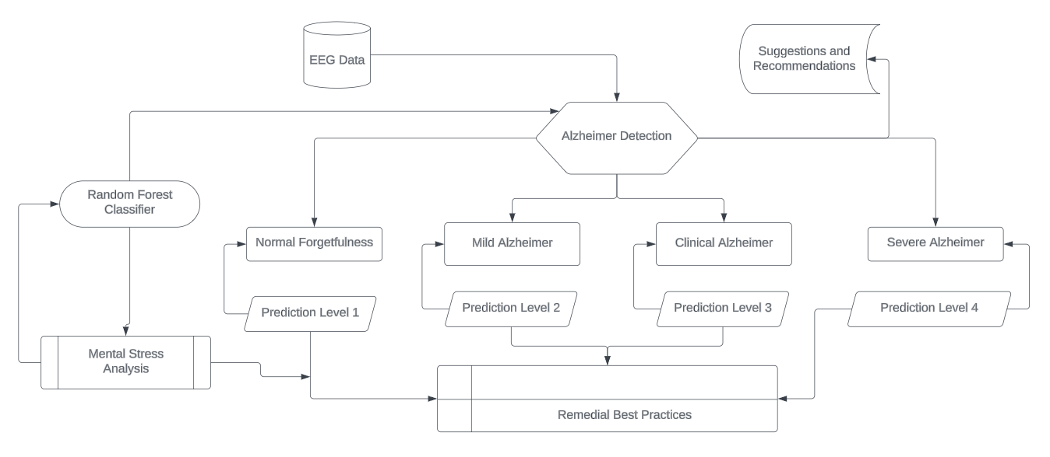
EEG ARCHITECTURE

Slide 14
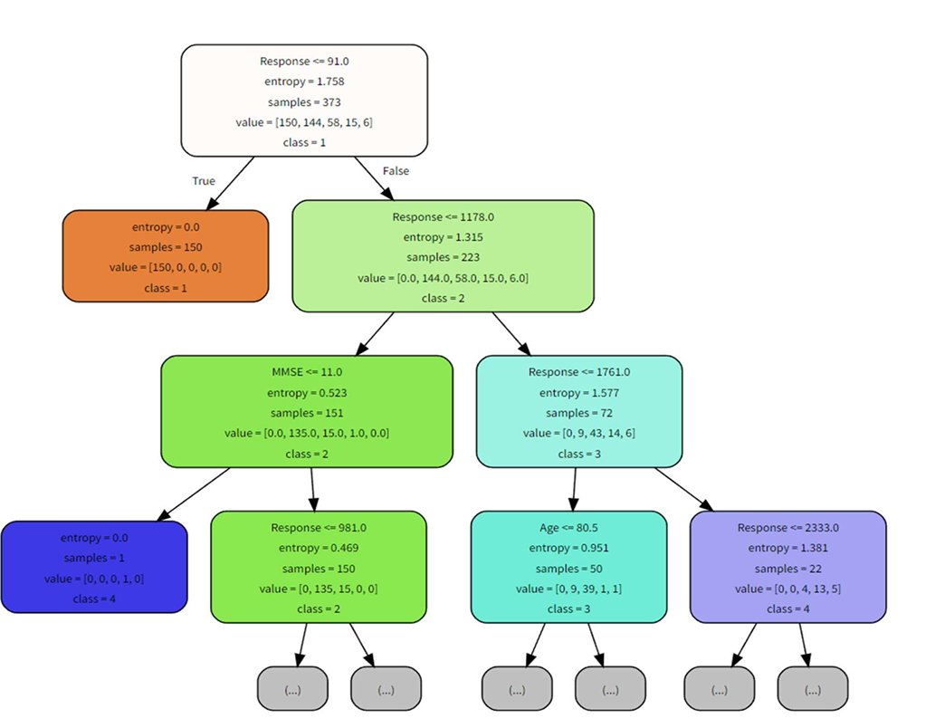
DECISION TREES MODULE FLOWCHART

Slide 15
PROPOSED MODULES
Data Collection
Data Pre-processing
Data Modelling
Data Analysis
Cross Validation
Model Generation

Slide 16
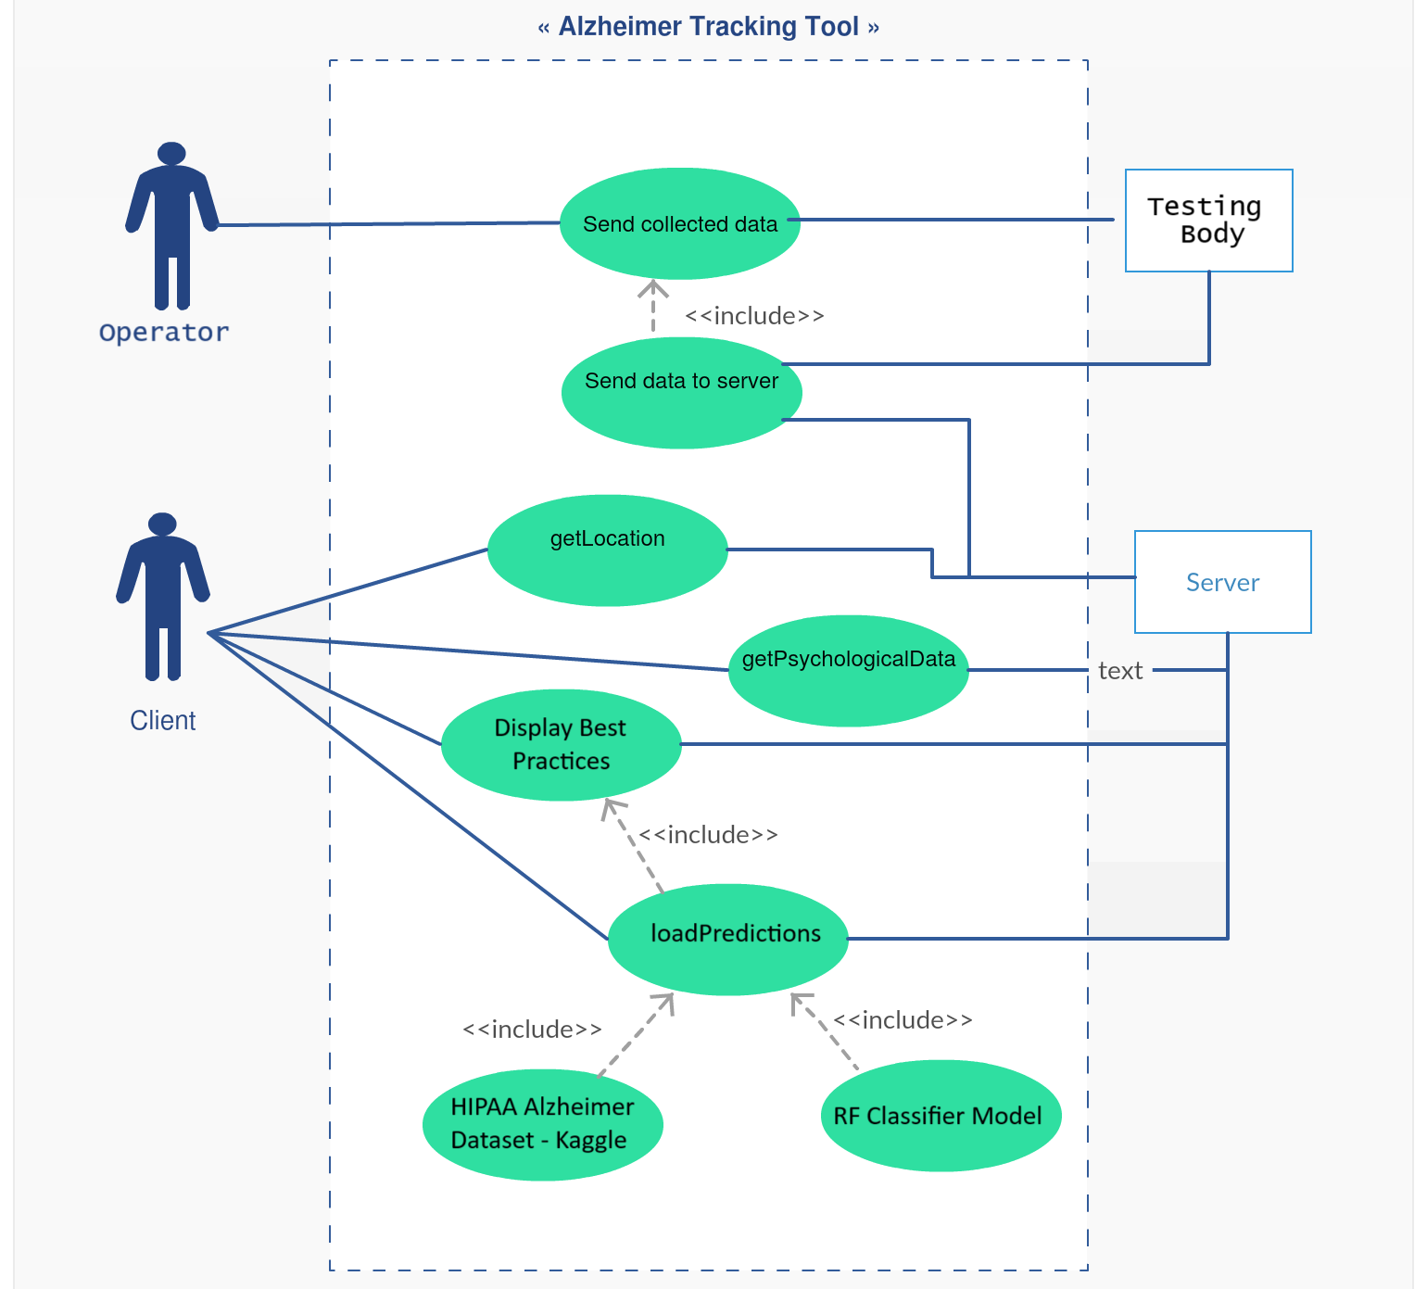
UML DIAGRAM FOR THE PROPOSED MODULES

Slide 17
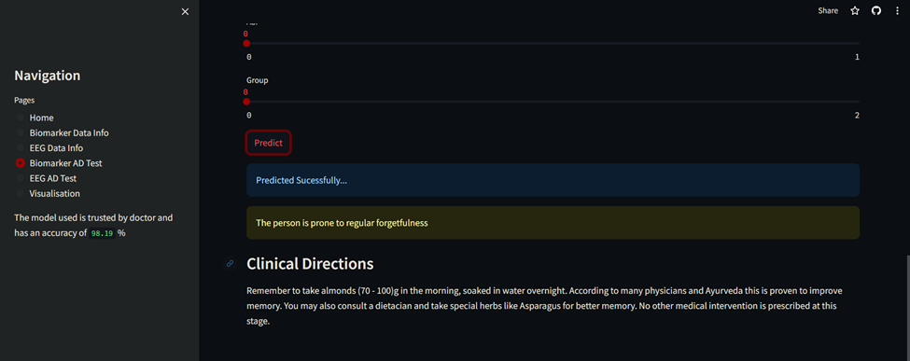
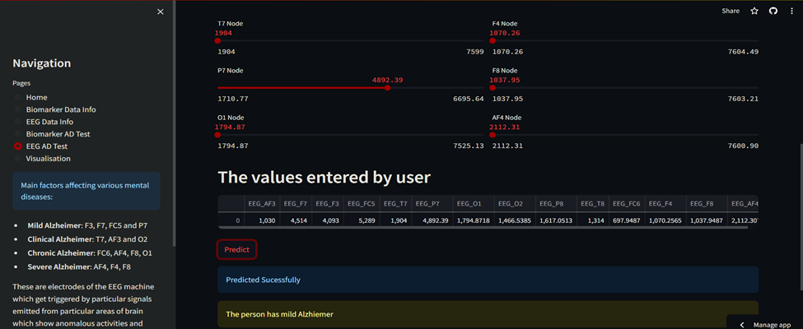
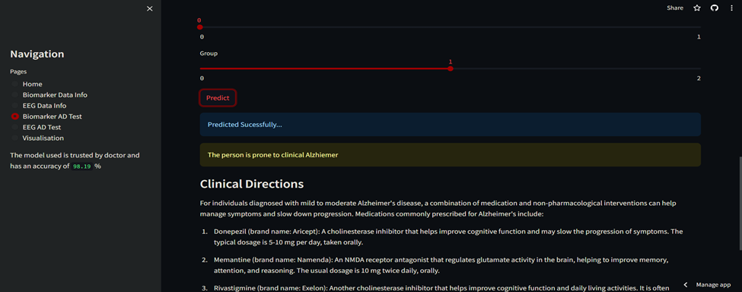
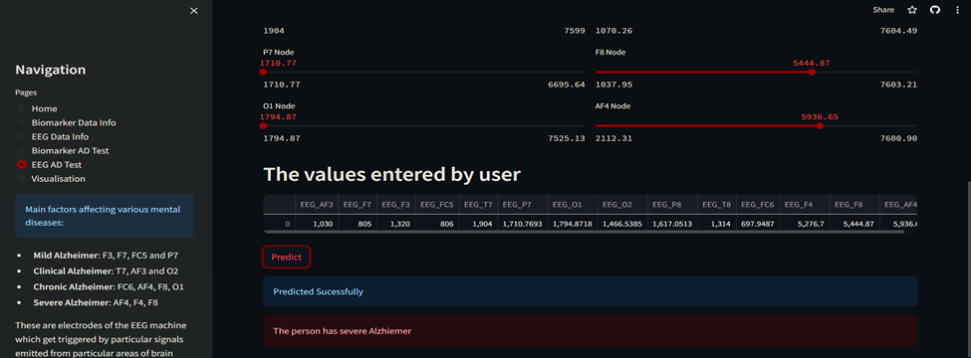
TESTING /INITIAL RESULT ANALYSIS

Slide 18
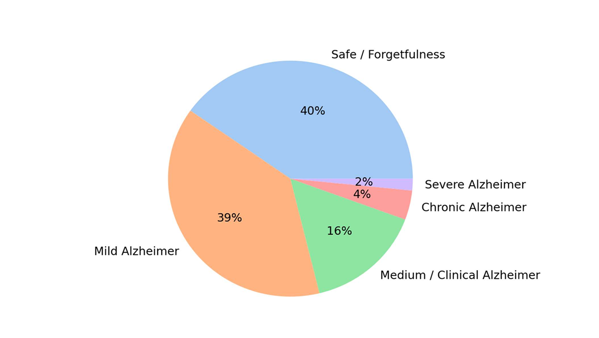
TESTING /INITIAL RESULT ANALYSIS

Slide 19
TESTING /INITIAL RESULT ANALYSIS
Accuracy achieved in the project : 97% (approx.)
Response time : 2 – 5 sec.
Best practices score as per Google Lighthouse Reports: 96%
The expected outcomes have been satisfied by the application
The UI is user-friendly and is solving the purpose.
The application works lag free on multiple browsers.

Slide 20
Thank You

